Slide 1


Visual Cryptography
PROJECT GUIDE PROF. PRAHALAD
RISHITHA OTRA PES2UG20EC070
SIDDHARTH S T PES2UG20EC087
YASH SANTOSH DABKE PES2UG20EC110
MANOJ S PES2UG20EC150

Slide 2
Title :
Colour visual cryptography using multilevel thresholding and AES algorithm with Autoencoders.

Slide 3
Description :
The project involves developing a secure image sharing system using color visual cryptography with the help of multilevel thresholding, AES encryption algorithm, and autoencoders. The system works by first thresholding an input image into multiple binary images using multilevel thresholding. Then, these binary images are compressed using an autoencoder and encrypted using AES encryption to obtain multiple shares. These encrypted shares are then distributed among the participants through a secure channel. To reconstruct the original image, the participants combine their shares using an XOR operation.
By using multilevel thresholding, AES encryption, and autoencoders, the system can ensure that the image remains secure during distribution, and by using autoencoders, the system can also improve the quality of the shared images.

Slide 4
Expectations
Understanding of visual cryptography concepts
Implementation of multilevel thresholding
Implementation of an autoencoder
Implementation of AES encryption
Integration of autoencoders and AES encryption
Evaluation of results
Demonstration of advantages of autoencoder
Overall, the project should demonstrate a thorough understanding of visual cryptography concepts and provide a practical implementation of a secure and efficient method for sharing images among participants.

Slide 5
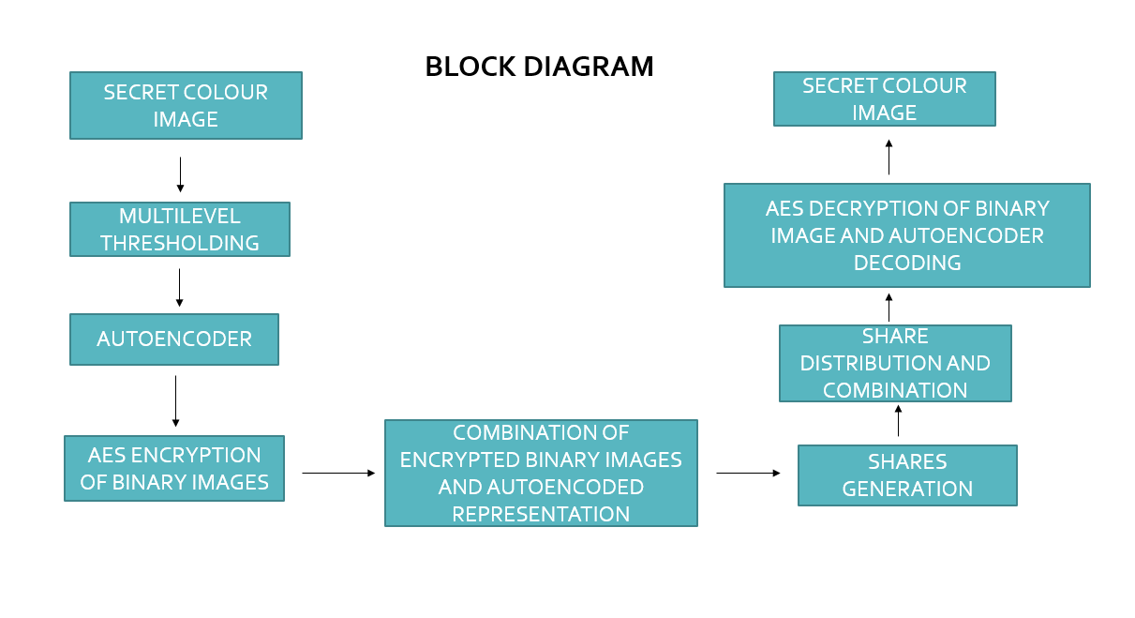
Block Level Representation

Slide 6
Multilevel Thresholding
Multilevel thresholding is a technique used in image processing to segment an image into multiple sub-images based on a set of predetermined threshold values. It is commonly used in visual cryptography to break down the secret image into simpler sub-images with varying levels of complexity.
In visual cryptography, converting the RGB color image to a grayscale image can also help to reduce the complexity of the thresholding process. Thresholding is typically performed on a grayscale image, where each pixel has a single intensity value, rather than on a color image where each pixel has three intensity values (red, green, and blue). By converting the RGB image to grayscale, we can simplify the thresholding process and make it easier to divide the image into multiple levels for encryption using visual cryptography.

Slide 7
Convert the original secret image to grayscale format, if it is not already in grayscale format.
Apply multilevel thresholding to the grayscale image to divide the pixel values into multiple levels, based on a set of predetermined threshold values.
Each level produced from multilevel thresholding is then halftoned using a halftoning algorithm to create binary sub-images, or shares.
Apply the halftoning process to each level of the thresholder image separately, resulting in multiple binary shares for each level.
The binary shares from each level are then combined to produce the final set of shares for the secret image.
Convert the binary shares to the RGB format by splitting the binary values of each share into separate red, green, and blue (RGB) components.
The RGB shares can then be transmitted or stored securely for later use.
To reveal the secret image, the correct shares are overlaid on top of each other according to the specific rules of visual cryptography. When the correct shares are overlaid correctly, the secret image is revealed.
The use of multilevel thresholding and halftoning can help to reduce visual artifacts and enhance the security of the encrypted shares. Additionally, converting the shares to the RGB format allows for greater flexibility in visual cryptography, as the shares can be transmitted or stored using a variety of media.

Slide 8
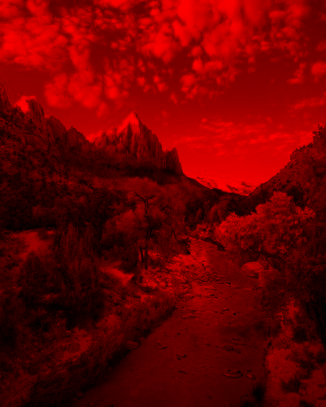


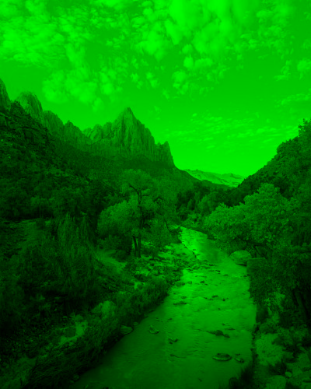
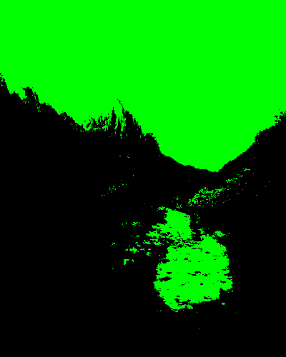
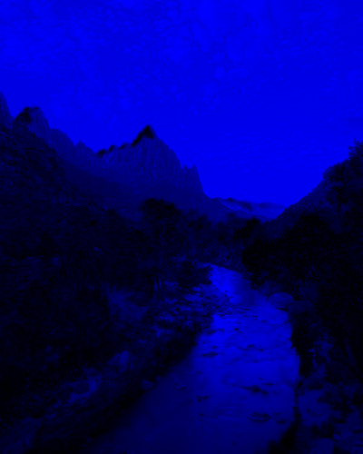
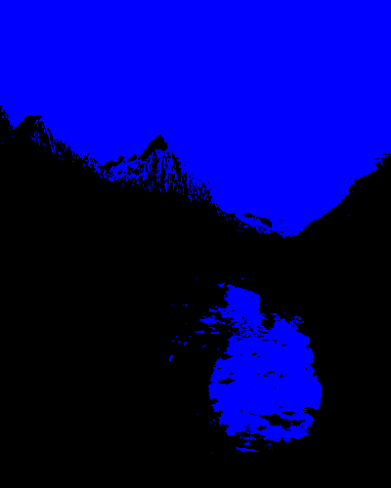
HALFTONING USING MULTILEVEL THRESHOLDING
RGB SPLITTING
Image Source : https://www.pexels.com/photo/photo-of-stream-during-daytime-3225517/

Slide 9
About Autoencoders :
We need to train the autoencoder to compress and reconstruct the shares in visual cryptography. The training process involves feeding the autoencoder with a set of input data, such as the shares obtained after multilevel thresholding and halftoning and optimizing its parameters to minimize the difference between the original input data and the reconstructed output data.
During the training process, the autoencoder learns to extract and represent the most important features of the input data, while discarding the redundant or noisy information. This helps to compress the input data into a lower-dimensional representation, which can then be used to reconstruct the original data with minimal loss of information.
Once the autoencoder is trained on a sufficiently large and diverse set of input data, it can be used to compress and reconstruct the shares obtained in visual cryptography, while preserving the confidentiality of the original data.

Slide 10
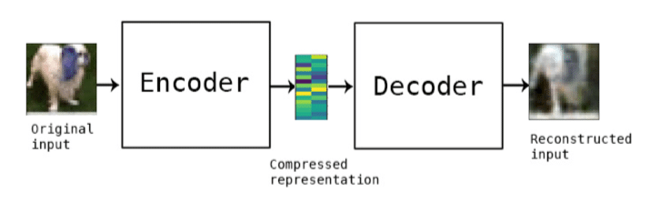
Autoencoder

Slide 11
Autoencoder – Before and after denoising
Image Source: https://futurism.com/learn-what-makes-your-dog-unique-with-the-orivet-dog-dna-test-kit

Slide 12
AES Encryption
After thresholding and compressing the shares using an autoencoder, AES encryption can be applied as an additional layer of security to protect the confidentiality of the shares.
AES (Advanced Encryption Standard) is a widely-used symmetric encryption algorithm that provides strong encryption and decryption capabilities.
To use AES encryption in visual cryptography, the compressed shares are first converted into binary format.
A secret key is then used to apply the AES algorithm to the binary data.
The resulting output is the ciphertext, which is then transmitted or stored, along with the decryption key that is needed to decrypt the ciphertext.
The use of AES encryption can provide an additional layer of security to visual cryptography by making it harder for unauthorized parties to access the original shares.
It is important to ensure that the secret key used for AES encryption is kept secure, as the strength of the encryption relies on the secrecy of the key.

Slide 13
AES Encryption
Choose an appropriate key size: AES supports key sizes of 128, 192, and 256 bits. Choose the key size based on the level of security you need.
Generate a secure key: Use a secure method to generate a key. The key should be random and not easily guessable.
Implement AES encryption: Implement AES encryption in your programming language of choice using a library or writing your own implementation. Make sure to use the key generated in step 2.
Encrypt the RGB components: After splitting the secret image into RGB components, apply AES encryption to each component separately. This will produce three separate encrypted images.
Combine the encrypted RGB components: Combine the encrypted RGB components to produce the final encrypted image.
Implement AES decryption: Implement AES decryption using the same key used for encryption. This will allow you to decrypt the encrypted image to reveal the original RGB components.
Combine the decrypted RGB components: Combine the decrypted RGB components to produce the original secret image.
Test the AES implementation: Test the AES implementation to ensure that it works correctly and securely.

Slide 14
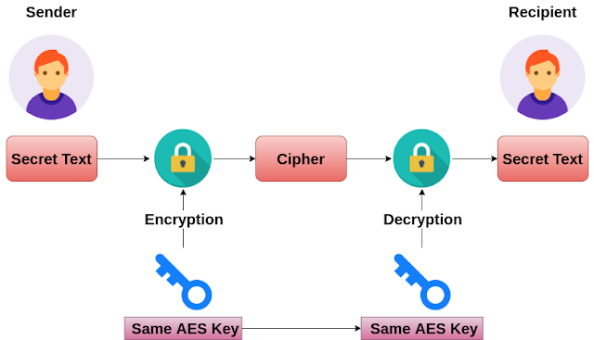
AES Encryption

Slide 15
Result
The final image is revealed by combining the original shares, which are superimposed on top of each other according to the rules of visual cryptography.
The use of multilevel thresholding, autoencoder compression, and AES encryption help to protect the confidentiality and quality of the shares.
Visual cryptography ensures that the secret image is only revealed when the correct shares are overlaid correctly.
The final image will be a less noisier version of the original secret image.
Multilevel thresholding can help to reduce visual artifacts and enhance the security of the encrypted shares.
The autoencoder compresses and reconstructs the shares to further enhance their quality and security.
AES encryption provides an additional layer of security to protect the confidentiality of the compressed shares.

Slide 16
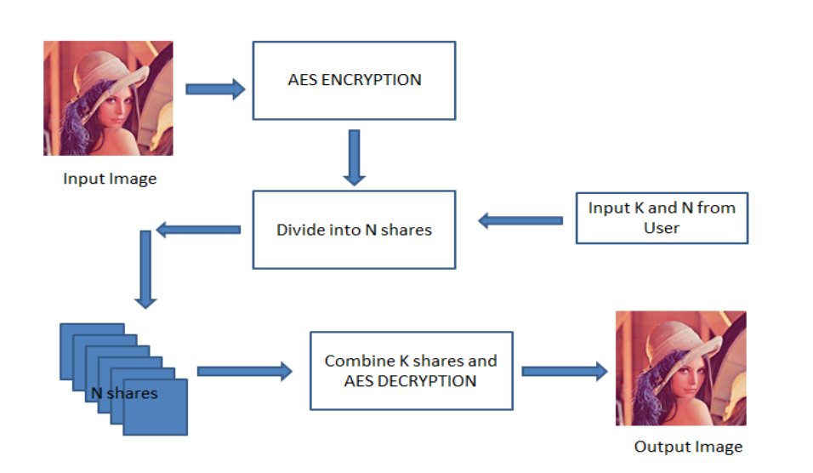
Result

Slide 17
Tools for Implementation
Popular libraries in Python include TensorFlow, PyTorch, and Keras, while libraries such as Cryptography and PyCrypto can be used for implementing encryption algorithms like AES.
In terms of image processing and visualization, tools such as OpenCV, Matplotlib, and NumPy can be useful. Additionally, tools like Jupyter Notebook or Spyder can be useful for developing and testing the code.

Slide 18
Project Expectation Fulfilment
Code implementation - The implementation of the project code can be demonstrated to show how each of the project expectations has been fulfilled.
Comparison of output and input images - The quality of the reconstructed shared image can be compared to the original image to demonstrate the successful implementation of the project.
Share size and distribution time analysis - The efficiency of the system can be demonstrated by analysing the share size and distribution time.
Presentation of results - The results of the project can be presented in the form of a report, presentation, or video demonstration. The report should include details of the methodology used, the code implementation, and the results obtained.

Slide 19
Thank You

